Slide 1
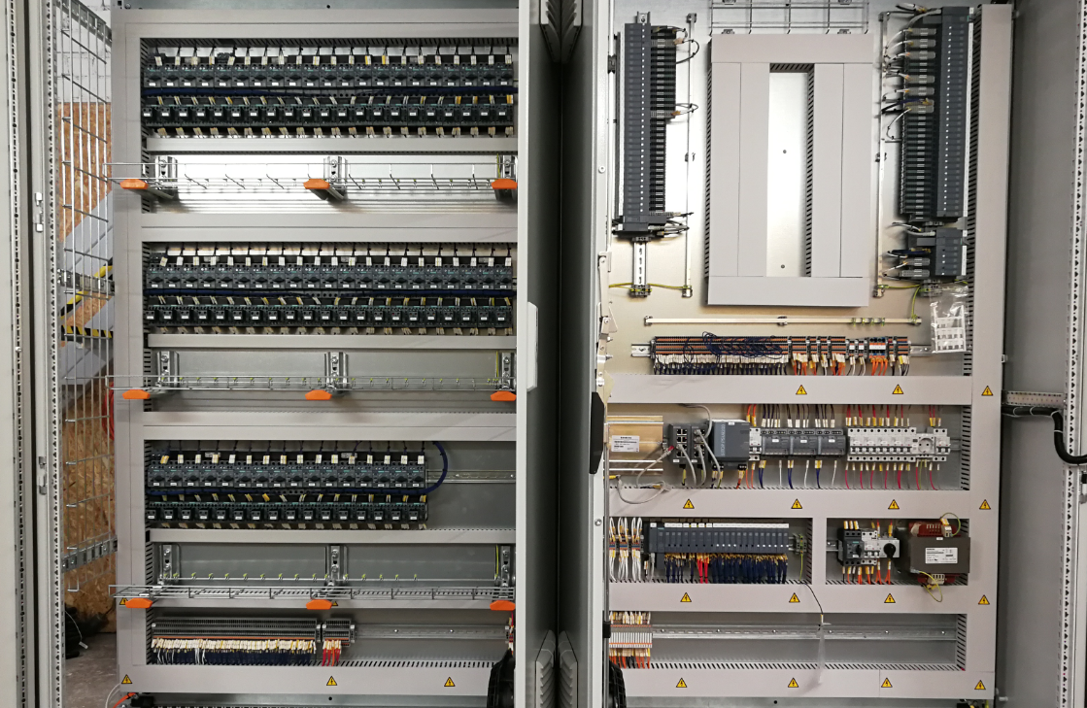

To secure strong position in European market, by providing best, custom-tailored automation solutions for any industry
Ensuring that automation solutions we provide, are both innovative and robust for modern industry needs
Modify approach to automation, that it is no longer a hard and questionable subject, but much rather mandatory part to achieve industrial excellence
Secure that customer experience we provide is as smooth as the automation we create
Provision of full life cycle support to any automation needs worldwide, by securing strong relationships based on integrity and personalized approach
Automation is the key for social distancing, no man – no risk. ;)
Automation for any nation. Black or white our SCADA will be right.
At ARiTeh we tend to put quality first, whilst satisfying industrial needs of our clients. Happy customers are likely to return.
We make things work autonomously, so our customers can focus on success. Beneficial partnership and top class quality is what makes us move forward.
ARiTeh SIA
Company profile

Slide 2

One point solution for your automation needs
Programming
Project Mangement
Installation & Commissioning
One point solution
Planning
Programming & Electrical design
Installations
Commissioning
Service & Support
PLC
SCADA
HMI
Greenfield & Brownfield experience
Dedicated PM
Clear GANTT with milestones
Meetings & visits
Subcontractor management
M&E works
Own supervision
Worldwide availability
Strong Quality Assurance
As used by

Slide 3
ABOUT US
ARiTeh was founded in 2009 as an electrical installation company for automation systems. Since then, ARiTeh has grown and expanded its services to include full automation system management and industrial engineering consulting.
Development lifecycle
2009
Started as electrical installation company
2013
Evolved in small scale consultancy
2018
Full scale Harbor terminal Bulk Handling System automation
2015
Reached 1m turnover
2020
Completed large scale airport automation project
2021
Increase in team size to allow for larger scope projects

Slide 4
DATA AND STATS
Over past 4 years we have relaised that we max out our capacity -> therefore we increased number of employees and aim for better than ever performance in 2021
Our employees with their dedication have proven to be the best asset, that we continiously increase and educate to support our customer need, wherever and whenever there is a need
We are proud to have a strong and reliable On Time delivery ratio – in Ariteh, we see this as a main indicator for customer satisfaction

Slide 5




OBJECTIVES
Quote for the right task, and stick to the promises
Manage projects in modern and transparent way
Dedicated sales team will always support your wishes and provide best possible quotation for your needs. Returning customers are our best success indicator.
Secure strong communication channels and dedicated resource for the project. Our project managers will find a solution whatever the problem whilst mitigating the risks.
Installations and aftersales support
Programming & Engineering
We not only carry out all types of M&E installations with 24-month warranty to all our works as standard, but also provide dedicated service plans to secure your uninterrupted operations.
From color change on your HMI to complete plant automatization our experienced engineers will provide consulting and innovative ideas to support your wishes.

Slide 6
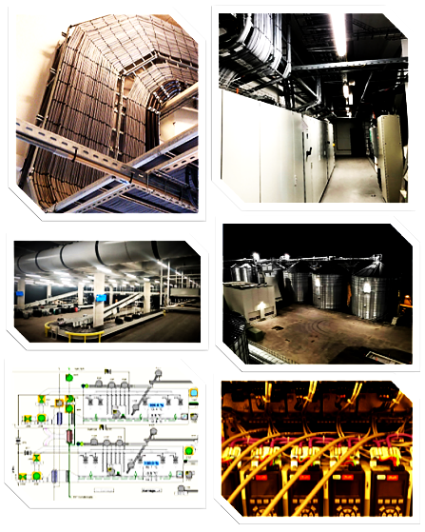

Our industries
SPX dairy plant; LatRaps KS Malt Factory; Andritz Group fish processing plant;
Food
Graakjaer A/S pig farms; GBT Grain Storage;
Agricultural
Ljubljana airport BHS automation; Charles de Gaulle BHS system upgrade;
Airport logistics
After 10+ years providing automatization solutions in various industries ARiTeh is one point solution for all logistics & manufacturing needs. Here are just a few examples of our completed projects:
Qubiqa clothing packaging;
Warehouse
Andritz Group wood pellet factory; Lachenmeier wood pellet Factory; Vorning Maskinfabrik Recycling plant, Pyrolysis plant in Denmark
Manufacturing

Slide 7
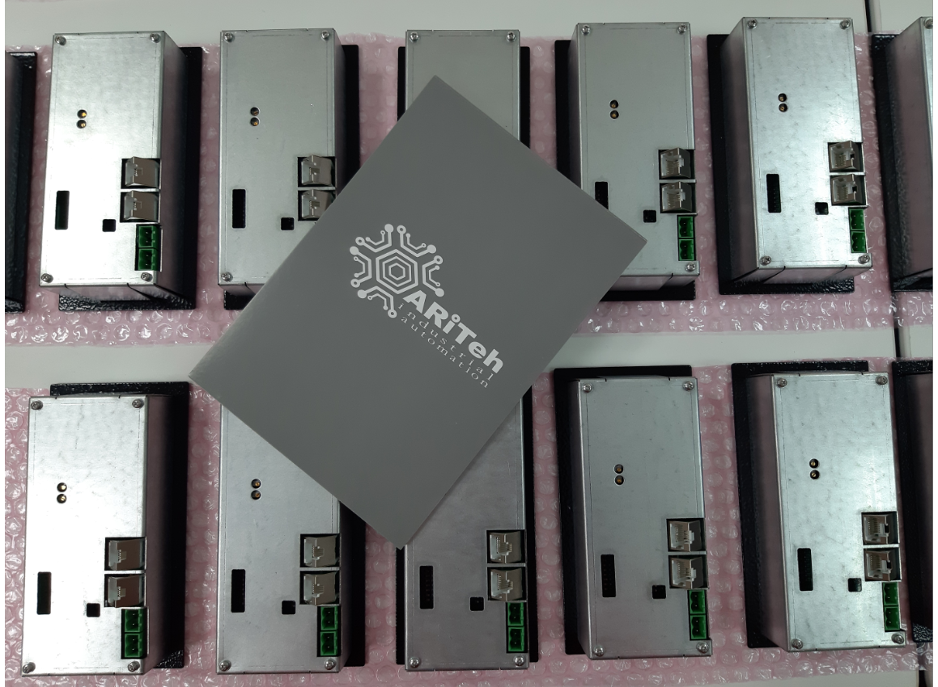
For all inquires or initial quotes, please contact us at:
@: info@ariteh.lv
Tel: +371 26492076
+371 26435389
Thank you

